Slide 1

Project Name – Student Course Registration System Name of Student – Saurabh Subhash Gaikwad Under Guidance of – Bharati Dewangan Mam Batch No – J27
SYMBIOSIS CENTER FOR DISTANCE LEARNING, PUNE

Slide 2
Agenda
Introduction
Overview of Project
Tech Stack and Requirement
Screen Designing .
Database Design /Tables
1.

Slide 3
Introduction
"Student Course Enrollment System," built using Spring Boot.
This system represents a fundamental yet powerful application that addresses the needs of educational institutions for efficient management of student course enrollment processes.
The primary objective of our Student Course Enrollment System is to streamline the course enrollment process, making it more convenient for students and administrators alike.
implemented basic CRUD (Create, Read, Update, Delete) functionality for both students and courses, allowing for the easy addition, modification, and removal of records
2.

Slide 4
Overview of Project
User-Friendly Interface: The system boasts an intuitive and user-friendly interface, making it easy for users to navigate and interact with the platform.
CRUD Operations: Basic CRUD (Create, Read, Update, Delete) functionality is provided for both students and courses, enabling easy addition, modification, and deletion of records.
Student Management: Administrators can register new students, update student details, view student information, and delete student records.
Course Management: Course-related tasks such as adding new courses, editing course details, viewing available courses, and removing courses are simplified for administrators.
Enrollment System: Students can conveniently enroll in courses they are interested in, while administrators can monitor course enrollments effectively.
Technology Stack:
Spring Boot: Chosen for its ease of development and robust web application capabilities.
Thymeleaf: Used for server-side HTML rendering, enabling dynamic web page creation.
MySQL: The database system of choice for securely storing student and course information.
Spring Data JPA: Simplifies database operations and facilitates object-oriented handling of database entities.
3.

Slide 5
Tech Stack Used :-
Front End Design : Html, CSS, BootStrap 4
Database : MySQL WorkBench 4.0
Back End : Java Spring Boot, JPA
Server : Tomcat 9.0
Hardware / Software :-
Hp G7 i3 – 8th Gen
Ram – 4gb
Storage– 500mb
Software – Eclipse IDE
6.

Slide 6
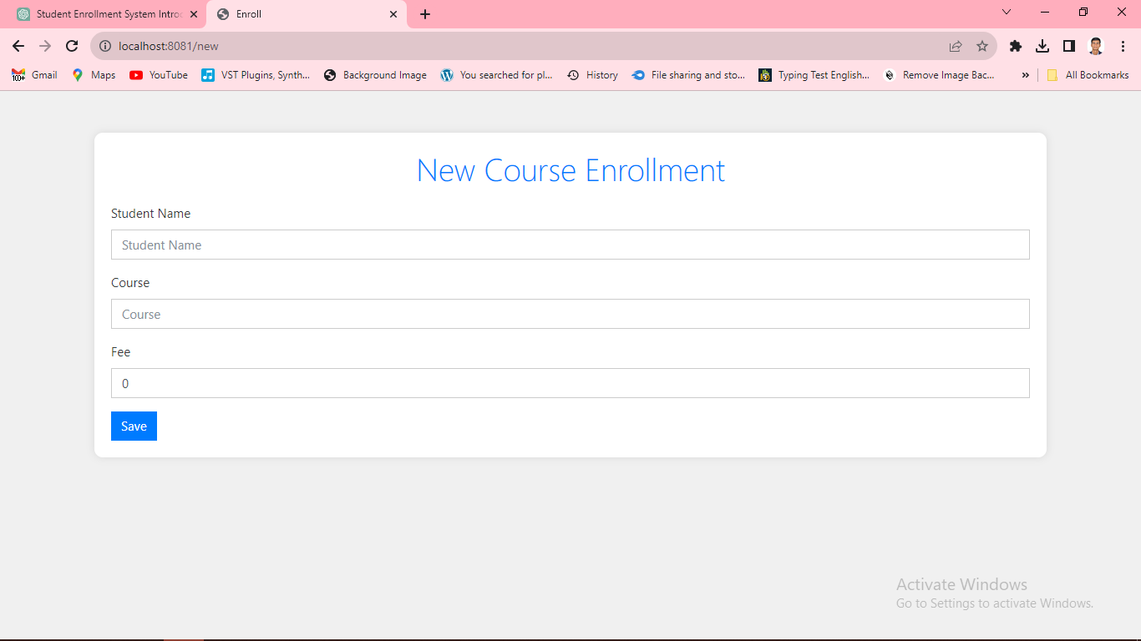
Screen Designing
New Course Enrollment.
11.

Slide 7
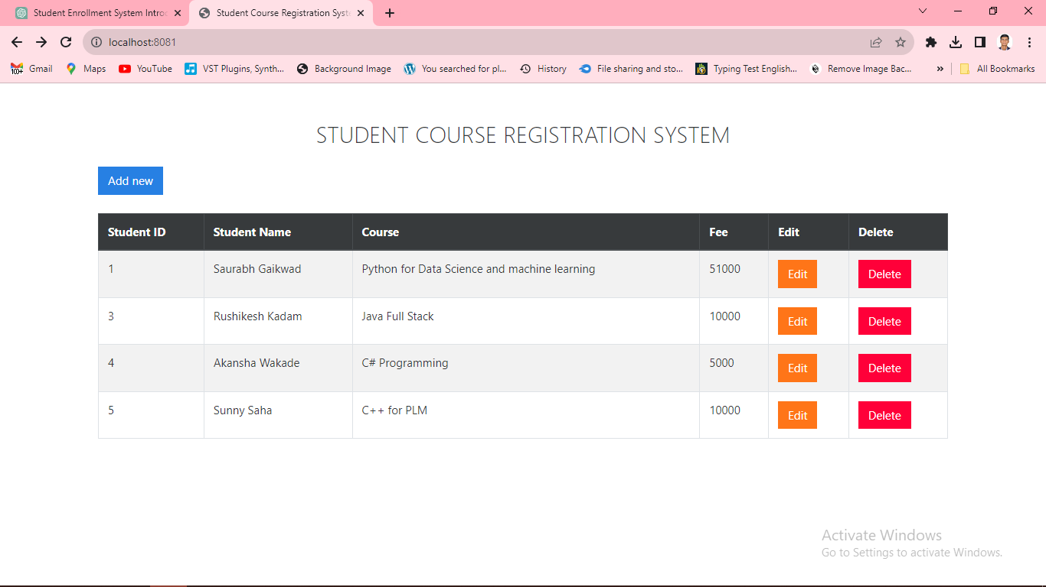
List of Students with Course.

Slide 8
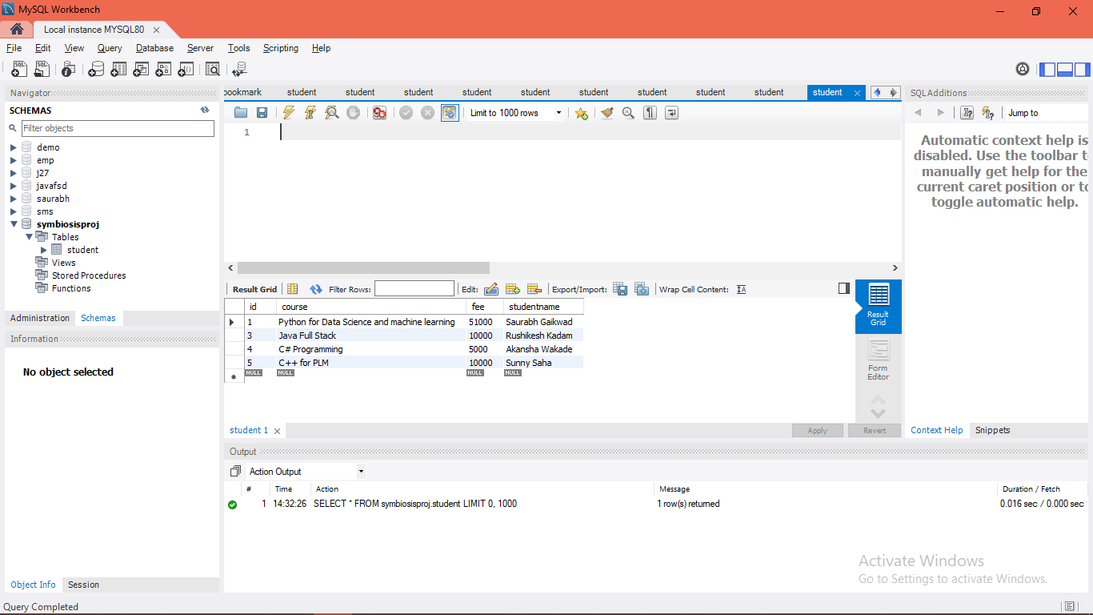
Database Desing :-

Slide 9
References -
Websites :
1. GeeksForGeeks
2. JavaTpoint
3. ChatGPT
Guidance :
1. Bharati Dewangan Mam.
14.

Slide 10
Thank You.

